Slide 1
Real-Time Disaster Training Monitoring System
A modern, professional emergency management dashboard — designed for real-time monitoring of disaster training programs, attendance tracking, and performance reporting.
UI/UX Design Presentation

Slide 2

SCREEN 01
Login Page UI Design
Design Overview
A clean, centered card layout with a modern logo, input fields, and a prominent login button. Responsive design ensures seamless access across devices.
Logo + system title header
Username & password fields with validation
Login button with loading state
Forgot Password link
Remember me checkbox

Slide 3
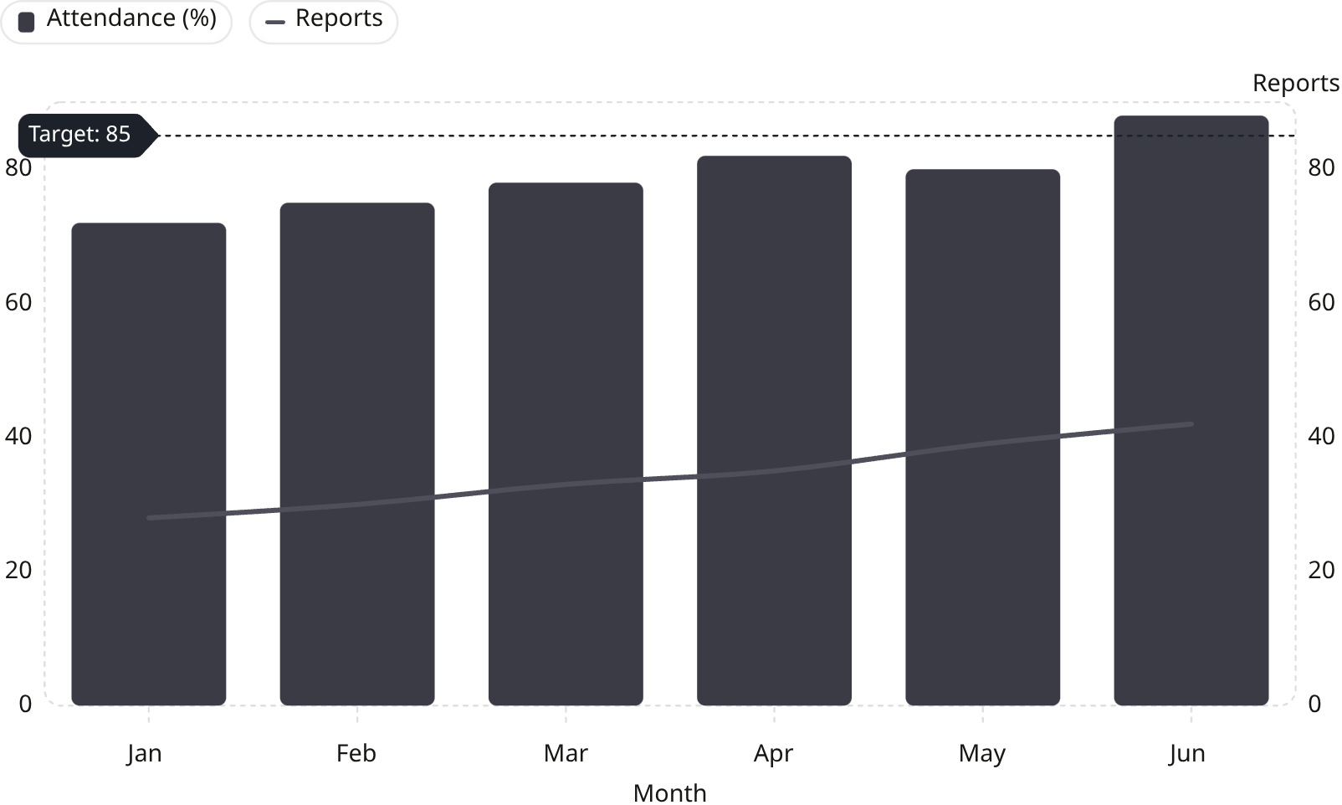
SCREEN 02
Admin Dashboard UI
The central command hub — giving administrators full visibility into trainers, trainees, active sessions, and system reports at a glance.
Sidebar Navigation
Dashboard Overview
Dashboard
Attendance Overview and recent activity snapshots help teams monitor usage, engagement, and reporting trends in real time.
Trainers
Trainees
Attendance
Reports
Logout
Total Trainers
Total Trainees
Active Trainings
Reports Generated
24
156
8
42

Slide 4
SCREEN 03
Trainer Dashboard UI
Empowering trainers with tools to manage sessions, track attendance, and evaluate trainee performance in real time.
Sidebar Navigation
Main Dashboard
Dashboard
A production-ready trainer workspace with today’s schedule, attendance tracking, live engagement updates, and performance review tools.
Schedule
Attendance
Live Activity
Evaluations
Settings
12 Trainees Present
3 Sessions Today
Attendance 96%
Performance Up 8%
Training Schedule
Attendance Checklist
Session
Time
Status
Aisha Khan
Strength Fundamentals
09:00
In Progress
Daniel Rivera
Mia Chen
Form Correction Drill
11:00
Upcoming
Noah Patel
Assessment Review
14:30
Scheduled
Sara Johnson
Recovery & Mobility
16:00
Scheduled
Lucas Martin
Live Activity Feed
Performance Evaluation
Score trainees, add remarks, and review session outcomes before publishing feedback.
09:12 — Aisha completed the warm-up circuit with perfect form.
Aisha Khan — 92%
Excellent consistency, strong technique, ready for advanced drills.
09:18 — Daniel logged a lap time improvement of 14 seconds.
Daniel Rivera — 88%
09:24 — Mia asked for a technique review on shoulder alignment.
Improving steadily; focus on pacing and recovery intervals.
Mia Chen — 84%
09:31 — Noah joined the session and marked check-in from mobile.
Solid engagement; needs refinement in posture during lifts.

Slide 5
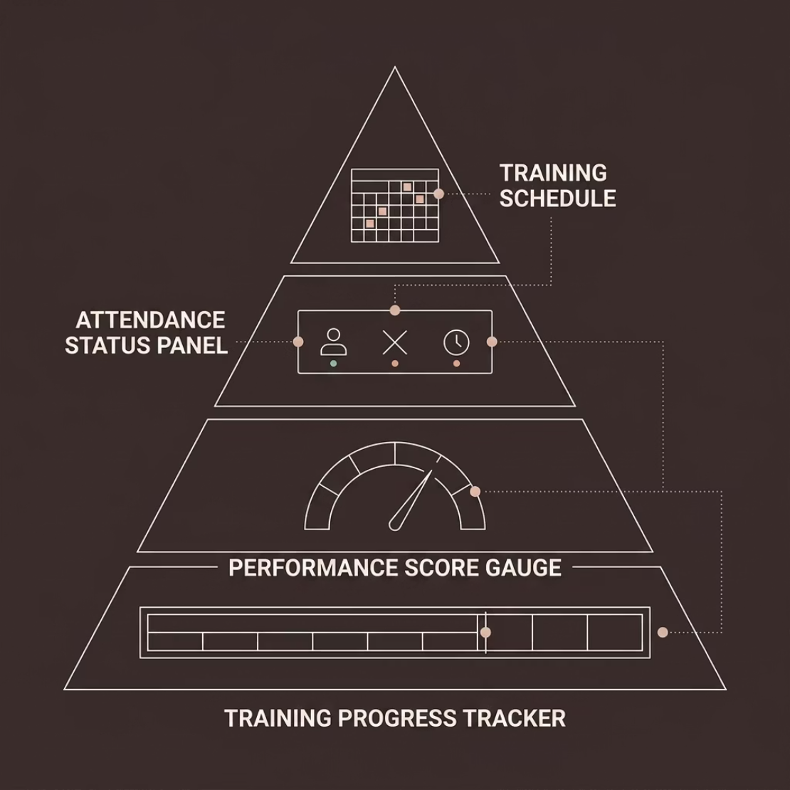
SCREEN 04
Trainee Dashboard UI
What Trainees See
A personalized, distraction-free interface focused on progress, schedules, and performance — keeping trainees informed and accountable.
Training Schedule
Attendance Status
Performance Score
Progress Tracker
Personalized timetable with session dates and locations.
Clear present/absent indicators with session history.
Aggregated scorecard with drill-wise breakdowns.
Visual progress bar showing completion percentage.

Slide 6


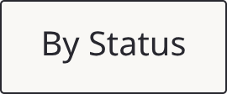




SCREEN 05
Attendance Monitoring Screen
Track trainee attendance in a clean, functional interface with quick filtering, search, and bulk actions for efficient session management.
Search: Alex Morgan, Fire Drill A, Jun 10...
Trainee Name
Session
Date
Status
Alex Morgan
Fire Drill A
Jun 10
Present
Jordan Lee
Fire Drill A
Jun 10
Absent
Sam Rivera
Evacuation B
Jun 11
Present
Casey Kim
Evacuation B
Jun 11
Present
Priya Shah
First Aid C
Jun 12
Present
Marcus Brown
Fire Drill A
Jun 12
Absent
Elena Garcia
Evacuation B
Jun 13
Present
Noah Wilson
First Aid C
Jun 13
Present
Mia Chen
Fire Drill A
Jun 14
Present
Daniel Patel
Evacuation B
Jun 14
Absent

Slide 7
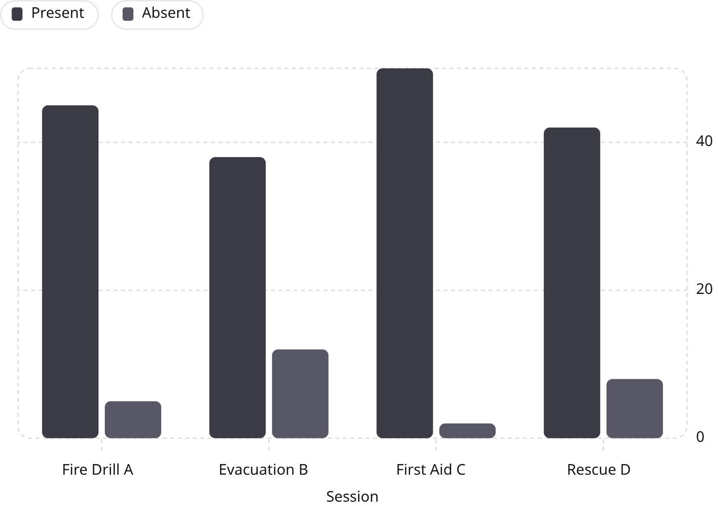


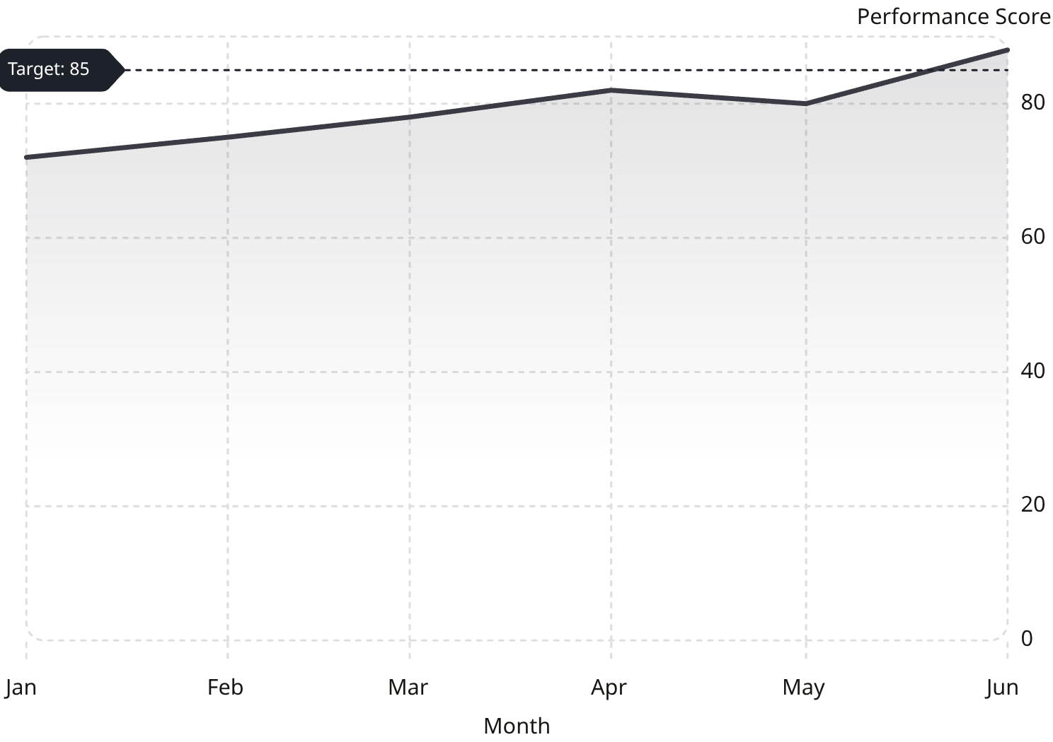
SCREEN 06
Report Generation Screen
Report Filters
Dashboard Charts
Date range
Session type
Trainee group
Status
Report Types
Attendance Report
Session-wise attendance summaries with exportable tables.
Performance Report
Trainee scores, trainer evaluations, and trend analysis.
Completion Report
Completion rates by session, group, and training stage.
Attendance by session is tracked alongside performance trends and completion rates to support stakeholder review.
The preview updates dynamically to show key metrics before export.

Slide 8
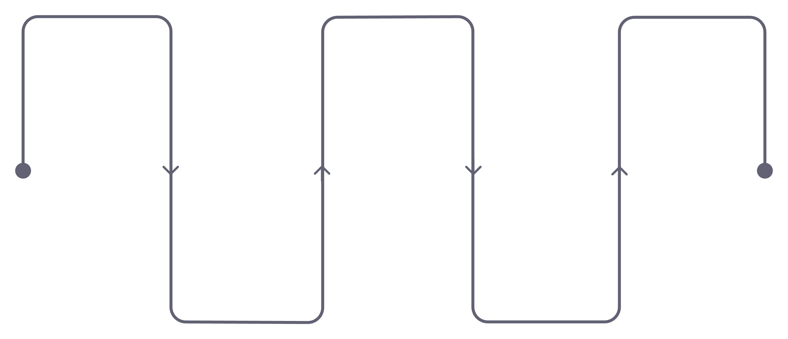
NAVIGATION
System Navigation Flow
A linear, intuitive user journey ensures every role — admin, trainer, or trainee — can access the right tools with minimal clicks.
Login
Attendance
Logout
Secure authentication
Monitor and manage
Secure session end
Dashboard
Reports
Role-based landing
Generate and export
Each screen transitions smoothly with clear breadcrumbs and consistent navigation patterns, reducing cognitive load for all users.

Slide 9
DESIGN HIGHLIGHTS
UI Design Features
Real-Time Monitoring
User-Friendly Interface
Responsive Design
Live data updates ensure admins and trainers always see the current state of every session.
Intuitive layouts with clear labels, minimal clutter, and guided workflows for all user roles.
Fully adaptive across desktop, tablet, and mobile — ensuring access in the field or office.
Secure Login
Dashboard Analytics
Role-based authentication with password validation, session timeouts, and access control.
Visual charts, KPI cards, and trend summaries provide actionable insights at a glance.

Slide 10

CONCLUSION
Ready for Implementation
The Real-Time Disaster Training Monitoring System delivers a complete, professional UI framework — from secure login to role-based dashboards, attendance management, and report generation.
Complete UI Suite
Modern Design Language
Faculty-Ready
6 screens covering all user roles and core workflows.
Clean typography, consistent cards, and SaaS-grade aesthetics.
Structured for project review, demonstration, and future development.
This system is designed for immediate deployment — scalable, secure, and built for real-world emergency training environments.

